Slide 1
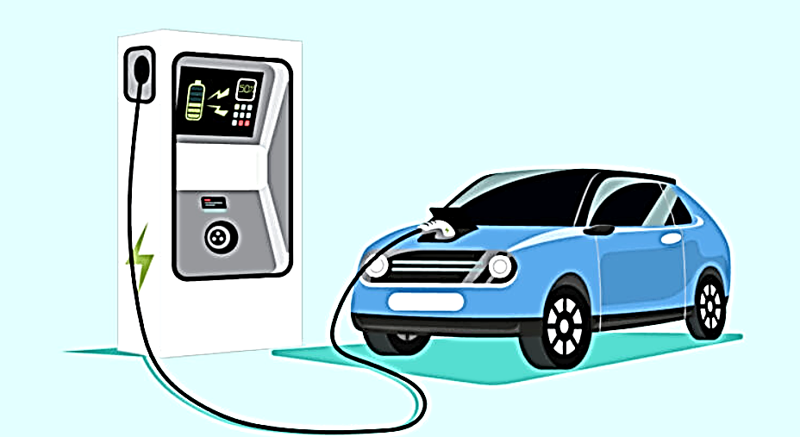
Introduction of electric vehicles

Slide 2

What are electric vehicles ...
An Electric Vehicle is a vehicle that operates on an electric motor, instead of an internal combustion engine that
generates power by burning a mix of fuel and gases. An electric vehicle is seen as a possible replacement for the
current-generation automobile in near future to address environmental challenges.
Inspired by road-going automobiles
powered by electricity.
Propelled by one electric motor or more
using batteries.
Electric motors give instant torque and
smooth acceleration.
Plug-in electric vehicles (EVs) are fast, fun,
and efficient. Maintenance is simpler and
cheaper.

Slide 3
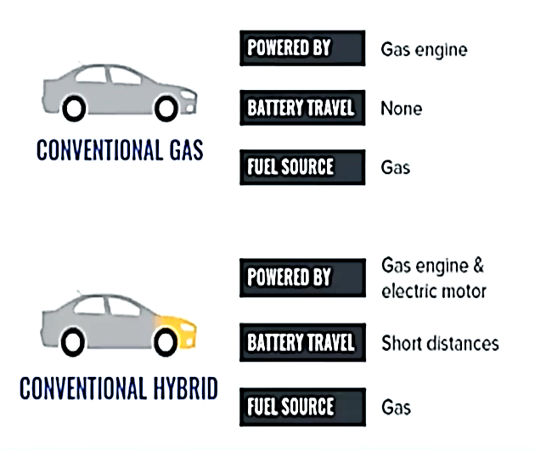
Vehicle Types – Gas
Gas:
Internal combustion engine
Transmission
Hybrid:
Adds battery, electric motor
Improved efficiency
Regenerative Braking

Slide 4
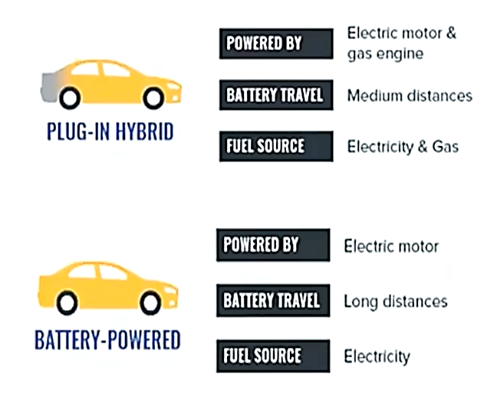
Vehicle Types – Electric
Plug-ln Hybrid
Larger battery than a regular hybrid vehicle.
Plugs in for electric mode
Long range
• Electric
Largest batteries
No gas engine
No tailpipe
High torque

